Slide 1
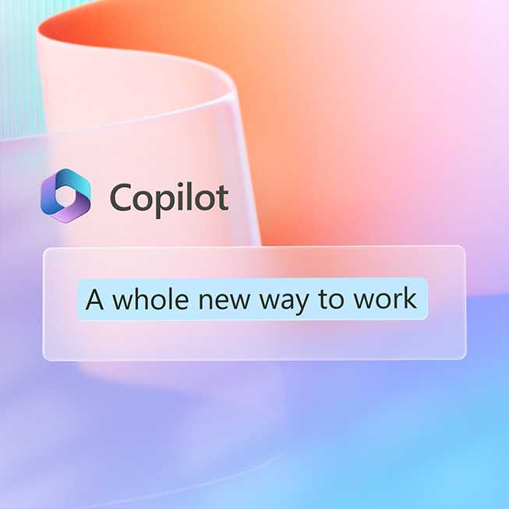
Building Customer-Centric Services offers
Copilot Offer Development Guide
April 2025

Slide 2

Guidance and purpose of this deck
Purpose | The purpose of this deck is to provide guidance to partners on building and publishing high-quality offers in the marketplace.
Audience | Microsoft Partners with a Copilot Practice and services
Usage guidance | This resource is designed to help you build, update, and publish high-quality offers in the marketplace, specifically related to Microsoft 365 Copilot and targeted at customers. Focus is on partners offering services to drive a Copilot for All strategy with customers covering Microsoft 365 Copilot, Agents, and Copilot Chat.
Level | L100
Deck Owner | Microsoft 365 Copilot Partner Product Marketing – Modern Work Jumpstart team
Last edited | April 2025
Confidentiality | DO NOT SHARE THIS CONTENT ON SOCIAL MEDIA. This deck is only for partner internal use. Do not share with customers or others.

Slide 3

Contents
Section | Purpose
Copilot Partner opportunity | What is the Copilot opportunity? Customer needs Total economic impact
Copilot Practices | Overview of ideal Copilot practices to offer in-market Customer GTM guidance
Anatomy of an offer | Ingredients of Copilot offers Key customer messages Offer construct
Publishing offer in AppSource/marketplace | Step-by-step guide

Slide 4


Why Microsoft 365 Copilot?
1
Consistent UI for AI
2
Integrated in the tools millions use every day
3
Platform for agents and extensibility
Microsoft 365 Copilot
4
Enterprise-grade security, privacy, and compliance
5
Flexible purchasing and deployment options
6
Measure AI impact and business value
Notes:
Copilot is a comprehensive solution for AI transformation.
Engage with Copilot chat with a standardized user experience across web, desktop, and mobile.
Copilot is integrated in the tools millions use every day, including Word, Excel, PowerPoint, Outlook, and Teams. Copilot provides a unified AI experience that works seamlessly across apps and experiences throughout your workday. ​It is grounded in Microsoft Graph, which provides trillions of signals from productivity and work data, which enables Copilot to provide more personalized and relevant responses.​
In addition to the productivity signals in Microsoft 365, you can also connect to additional business data sources, such as ERP, CRM, HCM, and custom applications, which allows Copilot to reason over all your enterprise data. You can choose from over 1,800+ pre-built connectors to get started.​ We recognize that every business is different, and so we offer no-code and low-code tools build custom Copilot agents. Copilot agents give Copilot new ways to access data and take actions. to customize the topics, knowledge, and actions available to Copilot agents so that they can meet the needs of specialized functions and tasks.​
Copilot inherits Microsoft 365 security, permissions, policies, and admin controls. There’s also built-in data governance with advanced enterprise data protection. All of this is done with our comprehensive approach to Responsible AI.​
Provides flexibility and choice to enable all employees with AI and access to agents as needed with subscription or pay-as-you-go options.
And finally, we provide tools to help you accelerate adoption and measure AI impact and business value. This includes tools like Copilot Lab and the Learning Academy to drive skilling and adoption, and the Copilot Dashboard to help you quantify the benefits. ​

Slide 5
What sets Microsoft 365 Copilot apart?
1
2
3
Personalized AI-first productivity app
M365 Copilot app connects to web, work, and business data and brings together chat, search, apps, and agents
AI integrated in the tools millions use every day
Copilot in Chat, Teams, Outlook, PowerPoint, Excel, and Word, including personalization and voice
AI Search
New AI-powered search integrated with chat and 80+ connectors so you can quickly find disparate information across your organization
4
5
6
Advanced Reasoning work agents
Researcher and Analyst agents with advanced reasoning over web, work, and business data act as virtual employees
Platform for agents
Extend Copilot with a broad set of pre-built agents or create your own with Copilot Studio, all available in the Agent Store
Copilot Control System
Robust security, management, measurement, and reporting for Copilot + Agents
Notes:
Microsoft is the partner for your AI journey. Here are the reasons why:​
The updated Microsoft 365 Copilot app enables a whole new way of work. It’s AI-powered productivity is personalized and designed to adapt to you. It learns what’s important to you and works the way you want to work. The app integrates AI for work in one simple tailored app that brings it all together.
Copilot is integrated in the tools millions use every day, including Word, Excel, PowerPoint, Outlook, and Teams. Copilot provides a unified AI experience that works seamlessly across apps and experiences throughout your workday. ​
With Copilot Search, we’re bringing the power of search and AI together to give you more relevant, context-aware search results. It connects your work data and dozens of apps so you can quickly find what you need.
Copilot is your window into agents – your new digital workforce – including Researcher and Analyst, two first of their kind with advanced reasoning agents for work. Researcher helps you tackle complex, multi-step research – delivering deeper, more complete findings. Analyst is built on OpenAI’s o3-mini reasoning model and optimized to do advanced data analysis at work – including knowing when and how to use Python.
We recognize that every business is different and so we offer no-code and low-code tools to build custom Copilot agents. Copilot agents give Copilot new ways to access data and take actions to customize the topics, knowledge, and actions available to Copilot agents so they can meet the needs of specialized functions and tasks.​ In addition to the productivity signals in Microsoft 365, you can also connect to additional business data sources, such as ERP, CRM, HCM, and custom applications, which allows Copilot to reason over all your enterprise data. You can choose from over 1,400+ pre-built connectors to get started.​ Copilot inherits Microsoft 365 security, permissions, policies, and admin controls. There’s also built-in data governance with advanced enterprise data protection. All of this is done with our comprehensive approach to Responsible AI.​
And finally, the Copilot Control System – a set of tools designed for IT professionals to better understand and manage AI within their organization, including security and governance to help ensure compliance and protection at every level, IT management controls to help ensure the right people have access to the right tools and are using them as intended, and adoption, measurement, and reporting tools to help you accelerate adoption and measure AI impact and business value.

Slide 6


Foundational AI Commitments
Microsoft commitments and controls
We secure your data at rest and in transit
You control your data
Microsoft 365 Copilot is built on trust
Your data is not used to train or enrich foundation models
You’re protected against AI security and copyright risks¹
¹ Learn more about the Customer Copyright Commitment | Microsoft
Notes:
Customers trust Microsoft 365 with their sensitive data because of the foundation of trust we have built through the commitments to protect customers and the controls we make available directly to customers. These same commitments and controls apply to prompts and responses in M365 Copilot and Copilot Chat.
When it comes to commitments:
We secure your data at rest and in transit. We help protect your data with encryption, at rest and in transit, rigorous physical security controls, and data isolation between tenants.
You control your data. Our time-tested approach to data privacy is grounded in our commitment to give you control over the data you put in the cloud. In other words, you control your data. Microsoft guarantees this with the contractual commitments we make to you.
Your data is not used to train or enrich foundation models. Prompts, responses, and web search queries in Copilot aren’t used to train foundation models.
You’re protected against AI security and copyright risks. We help safeguard against AI-focused risks such as harmful content and prompt injections. For content copyright concerns, we provide protected material detection and our Customer Copyright Commitment.

Slide 7
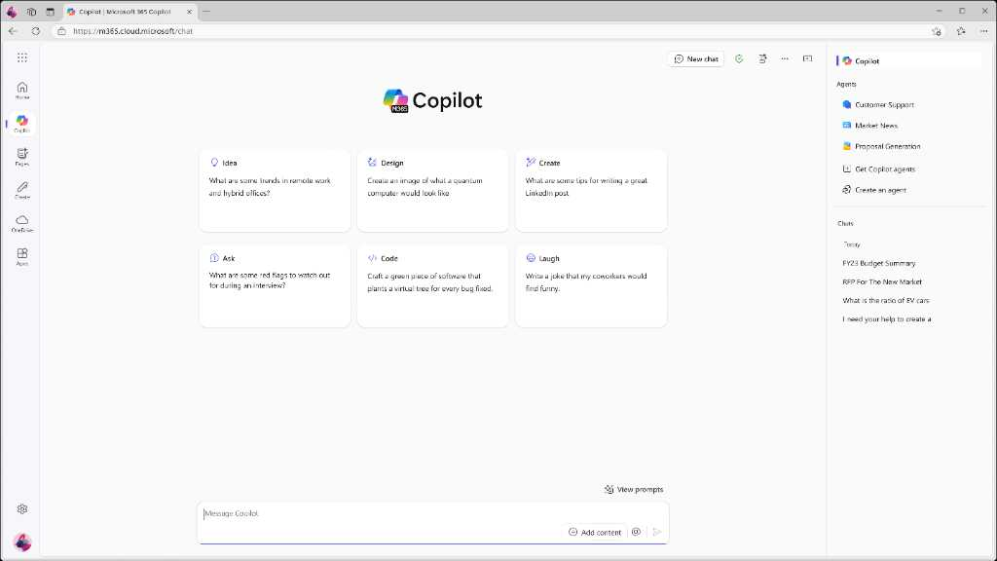
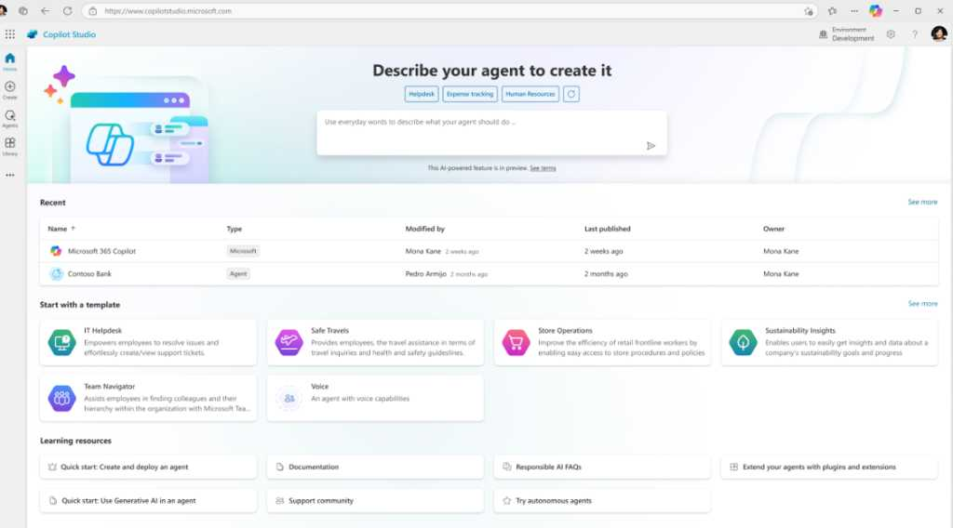
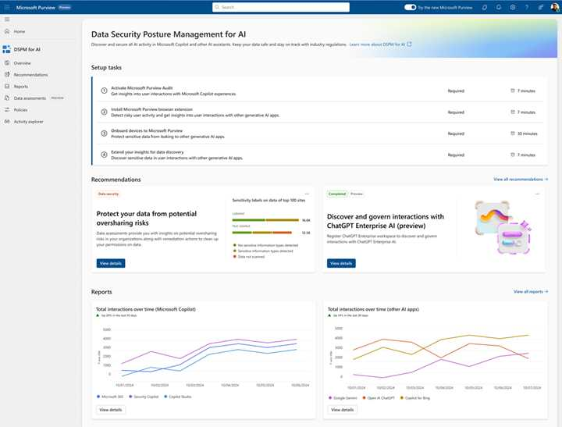
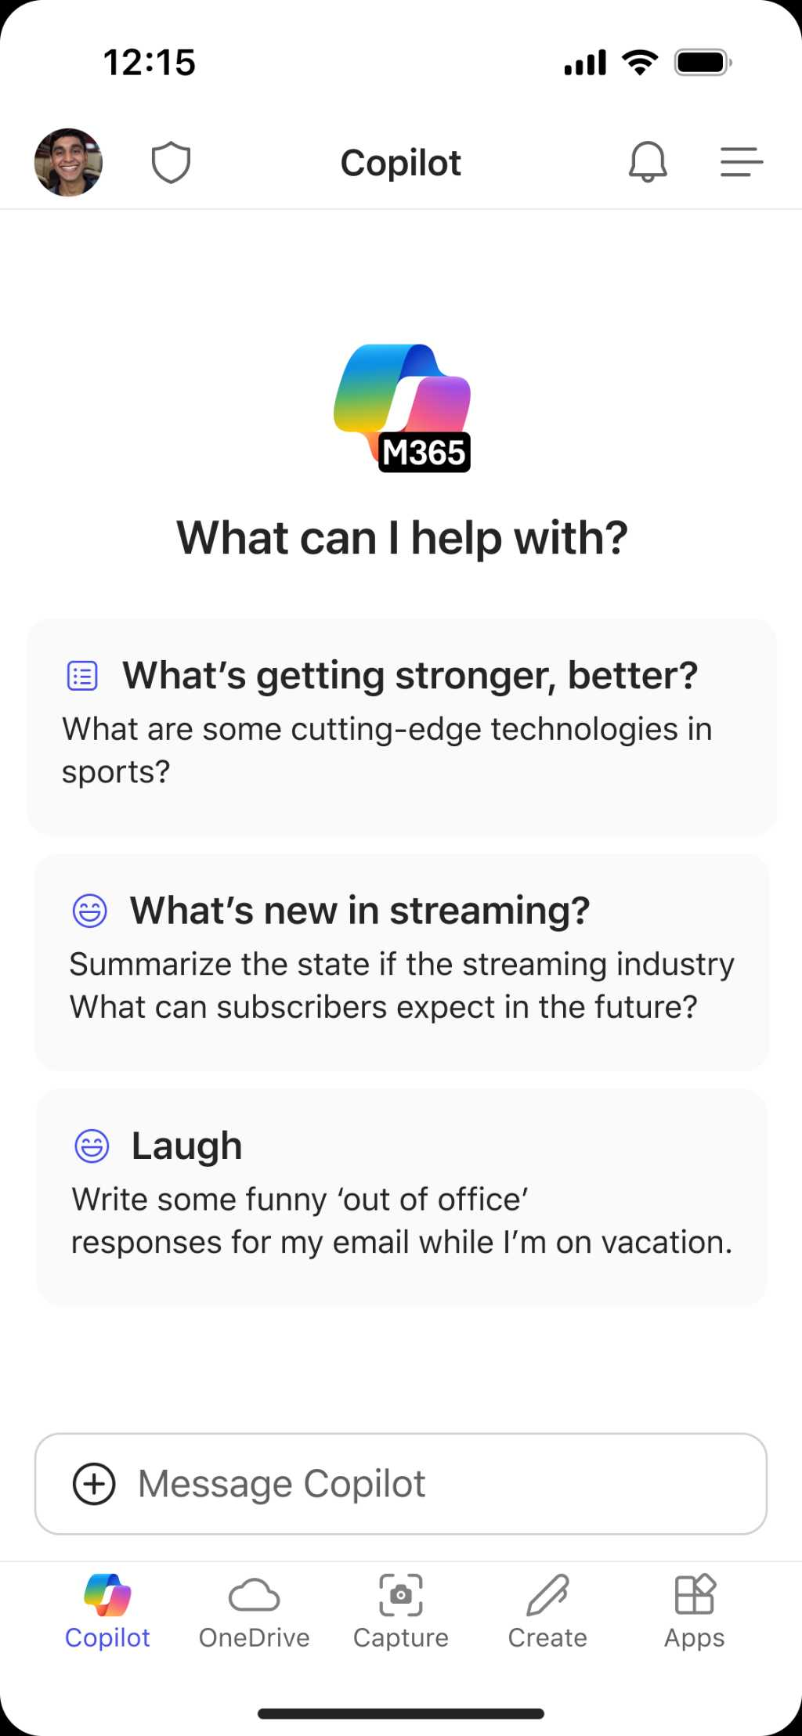
Microsoft 365 Copilot Chat
Chat
Agents
IT Controls
Free, secure AI chat –
powered by GPT-4o and web grounded
Integrated into the chat experience and paid for on a consumption basis
Enterprise Data Protection
and agent management
Notes:
That’s why we’re excited to introduce Microsoft 365 Copilot Chat. A new way for EVERY organization to quickly and securely scale AI adoption so no employee is left behind.​
Copilot Chat combines three valuable capabilities in one, integrated product:
At its core, it’s free, secure AI chat powered by the latest models and with its broad knowledge pulled from both the models and the web.
In addition to chat, agents, provide a powerful way to automate business processes. Agents are accessed through the same intuitive chat experience. Agents come in different flavors, from free agents grounded in things like instructions, public websites or uploaded files to paid agents that can access your organizations’ shared tenant data or third-party data. Copilot Chat offers these paid agents on a metered basis, so you only pay for what you use.
Copilot Chat offers robust IT controls, ensuring enterprise-grade security, privacy, compliance, and management. It provides the same level of security and privacy for Chat as you get from M365 for your email and documents.

Slide 8

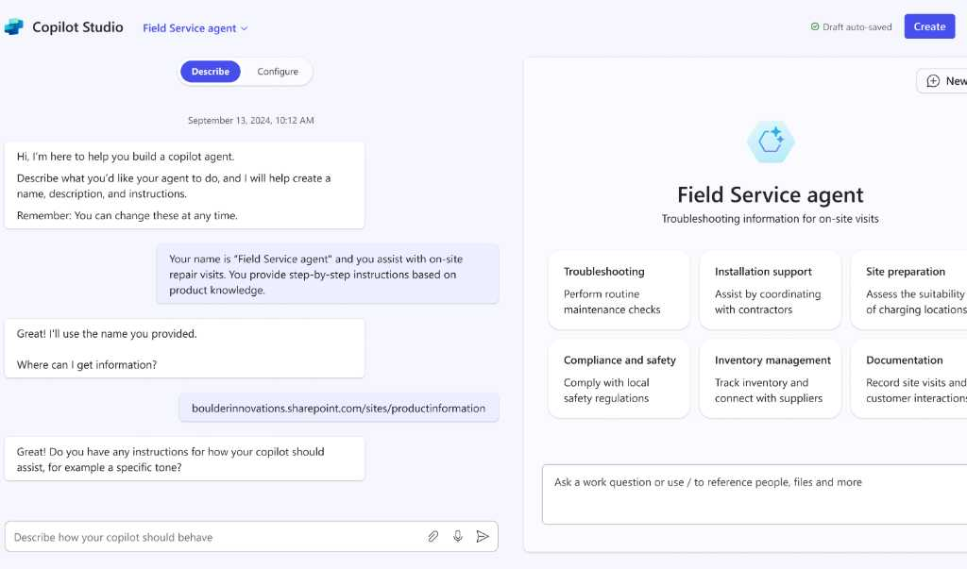
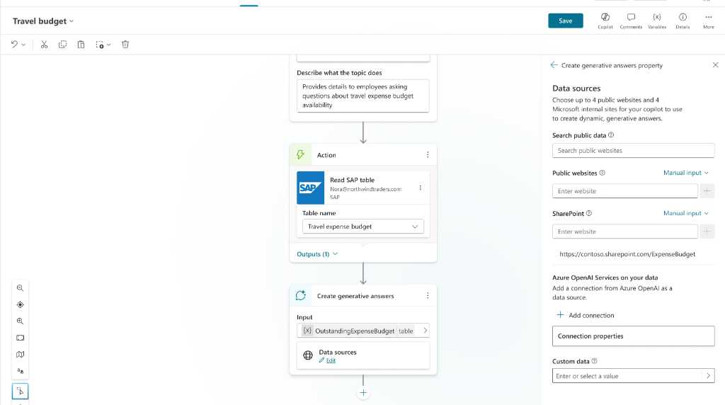
Copilot Studio
Copilot Studio is our low-code tool for creating agents and extending M365 Copilot.
For end users
For IT & developers
Copilot Studio agent builder in Microsoft 365 Copilot BizChat and SharePoint
Copilot Studio Full-featured graphical authoring environment

Slide 9


Microsoft 365 + Microsoft Purview are a complete solution to secure and govern Copilot
Secure
Govern
Honors your existing permissions | Supports your lifecycle policies and audit requirements
Protects against data loss and insider risk | Detect and investigate non-compliant and unethical usage
Assess oversharing risks and apply recommended corrections | Guided assistance to remain compliant with AI regulations
Microsoft 365 Copilot
Microsoft Purview
A complete solution to secure and govern Copilot

Slide 10
Activate the power of Copilot with customers
1
2
3
4
5
1
2
3
4
5
Position Wall-to-Wall Copilot coverage for all users
Build intent by delivering immersive customer experiences, like prompt-a-thons
Enhance Copilot with Agents’ experiences to transform business process
Land business value and ROI with healthy usage
Align with Microsoft sellers to drive upsell and conversion
Immersion | Extensibility | ROI
Notes:
Deploy Agents and drive Business Value across various functions and industries.
Enhance Copilot with Agent experiences to transform business process.

Slide 11

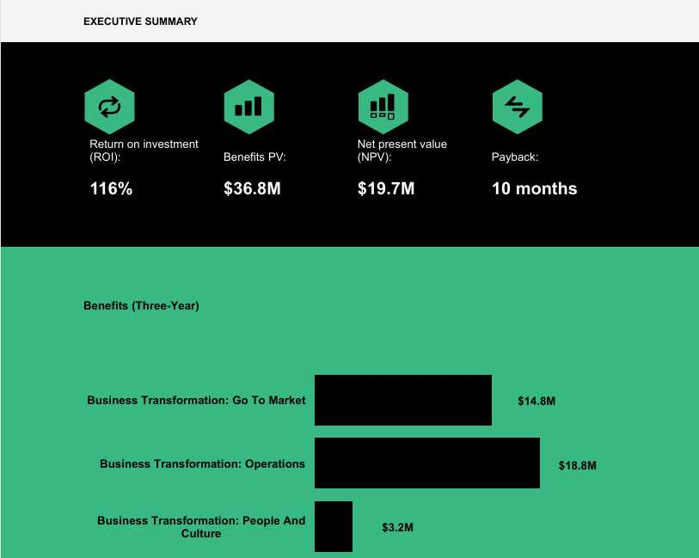
M365 Copilot Total Economic Impact (TEI) by Forrester
Increase revenue
1-4%
revenue lift from existing and new business¹
Optimize costs
0.7%
reduction in total operational expenditures¹
Employee experience
51.9%
of companies surveyed cite employee well-being as a top outcome¹
https://aka.ms/CopilotM365TEI
¹ Forrester Consulting, New Technology: The Projected Total Economic Impact™ of Microsoft Copilot for Microsoft 365, commissioned by Microsoft, April 2024.
Results based on a composite organization made up of 8 organizations as stated in the linked study.
Notes:
FY26 Market drivers
78% of AI users bringing their own AI tools to work
40% of organizations are doubling their investments on AI
Background
Ran from September 2024 to March 2025
Consisted of:
16 in-depth interviews with customers
350+ survey responses from customers
+ Agent-specific customer interviews
Includes an Agent Spotlight (see page 35)
Overall
116% Return on Investment (ROI)
$19.7M Net Present Value (NPV)
Metrics
2.5% increase in sales win rate
9 hours saved per M365 Copilot user per month
25% acceleration in new employee onboarding
2.7% increase in opportunities
1% increase in customer retention

Slide 12
Copilot Services Partner Capability View
Initiation
Activation
Impact
AI + Copilot Advisory
Copilot Deployment + Data Governance
Adoption + Change Management
Extensibility
GenAI Advisory
Advise customers on their GenAI transformation strategy, connecting to top business objectives and priorities.
Readiness
Advise customers on tenant readiness to adopt Copilot Chat and Microsoft 365 Copilot with a structured process and remediating data security blockers.
Engagement Strategy
Design a plan that outlines communication and workforce transformation strategy that aligns with overall GenAI strategy to effectively drive adoption.
Agent & Automation Strategy
Define a strategy to extend Microsoft 365 Copilot. Solution may include agentic scenarios by industry, function, and persona, including the problem, solution, and key metrics for success and monetization strategy.
Business Transformation
Drive scenario discovery and solution design leading to transforming business processes, workforce, leadership, and culture transformation.
Deployment
Optimize and deploy Microsoft 365 Copilot and/or Copilot Chat and conduct ongoing service health reviews.
Security and Compliance*
Address and remediate security and compliance concerns. Implement governance policies to manage the environment.
People Transformation
Lead Copilot adoption by training users, building skills, knowledge, and mindsets necessary to transform customer’s work using AI.
Agent Development*
Use tools like M365 Agent Builder, Copilot Studio, Power Platform, Azure AI Foundry to create and deploy agents supporting complex customer scenarios.
Plugins & API Integration
Extend Copilot capabilities using Microsoft Graph API, custom plug-ins, and Power Platform for deep system integrations.
Business Value*
Help customers realize the ROI of their Copilot investments and quantifying benefits, i.e., using Copilot Analytics to analyze ROI and drive changes in Adoption and Change Management strategy.
Impact Measurement*​
Use Copilot Analytics to track impact of AI and show value realization.
* Key capability focus in FY26

Slide 13
Partner services practice activation
AI + Copilot Advisory
Copilot Deployment + Data Governance
Adoption + Change Management
Extensibility
M365 Copilot
[Users ready for M365 Copilot]
Assess customer technical readiness, close gaps
Run data security assessment(s) with Microsoft Purview
Address oversharing concerns
Extend M365 Copilot by building agents
Bring customer business data to measure ROI with Copilot Analytics
Help customers build AI transformation strategies
Develop business case and expected ROI to drive M365 Copilot purchases
Adoption plan
Readiness
Establish a Copilot COE
Measure impact
+
+
+
+
Copilot Chat
[Everyone else]
Expand AI transformation scope to include all users and processes
Define governance model
Set up agent consumption model
Build Champions Networks
Deliver training to drive higher usage and adoption
Build agents for high-value scenarios:
Autonomous
Declarative
Frontline
Pre-sales
Sales
Post-sales

Slide 14
Partner opportunity with Agents
Develop agent repeatable IP
Develop COE or Agent Factory
Build custom agents for customer
Complexity of Agent Skills
Customize pre-built agents
Pre-built agents
Partner Services Opportunity
Notes:
The higher the complexity of agents, the greater the partner opportunity.

Slide 15

Implement functional go-to-market strategies across services
Enhance your current service offerings by considering your customer’s industry and functional business needs in each stage of their Copilot journey.
Incorporate your functional GTM strategy
AI & Copilot Advisory
Engage with business leaders and decision makers to uncover the high-value functional scenarios within their business.
Get ready and deploy
Identify key technical components of each business function and create a deployment plan for each scenario.
Adoption and change management
Craft custom change management programs that support your customer’s functional needs and prove ROI.
Extensibility
Help customize the Copilot experience with agents that bridge solutions that cater to your customer’s specific functional scenarios.

Slide 16
Driving AI transformation with your customers
Be the AI & Copilot Advisor to business decision makers
Get customer ready for Copilot addressing data security and privacy
Deliver end-user Copilot adoption and change management
Extend Copilot and transform business processes with agents
1
2
3
4
5
Listen & consult
Inspire & design
Empower & achieve
Realize value
Manage & optimize
Build Pipeline
Target customers and execute campaigns
Customer propensity list
Design solution
Build customer intent
Rapid evaluation to expand Copilot seats
Win deal
Influence or close the M365 Copilot sale
Deploy/drive usage
Address data security and privacy while driving end-user enablement
Drive expansion
Build business case for expansion
Extend business value with agents
Claim Copilot CPoR
Campaign in a box
(11 Languages)
Copilot Accelerate engagements

Slide 17
Position Copilot offer to include functional scenarios and key business outcomes for customers
Overview of your offer around expanding Copilot usage by driving business transformation with AI.
Brief description with AI keywords and a summary of the business impact.
Customer one-pager, including:
Solution and practice overview.
Hero offer for customer (workshop/demo/assessment).
Business benefits and impact.
Industry references.
Deployment framework and technical architecture.
Offer summary
Collateral

Slide 18




Anatomy of the offer: Construct offer pitch
Summarize your narrative that best describes the services and IP required to deliver on the core pillars of the Microsoft 365 Copilot Solution Play. Think about the transformative value of expanding your Copilot offers to accommodate functional scenarios and business KPIs.
AI and Copilot advisory
Short description of your offer
Consider services that:
Inspire quick wins and continue driving Copilot adoption: Begin with the basics, build foundational skills, and help customers get value out of the box.
Expand Copilot usage to business functions and role-based use cases: Move beyond basic skills and grow value by optimizing functional processes and impacting role-based metrics with Copilot.
Tailor data, systems, and workflows through extensions and build custom AI capabilities: Extend Copilot to enable the identified scenarios tailored to specific roles and personalize generative AI experiences.
Drive customer adoption and change management across the organization: Scale adoption of new use cases across the organization, prioritizing training and continuous improvement around business functions and role-based metrics.
Get ready and deploy
Unique value prop detailing why it is beneficial to engage
Adoption and change management
Business value proposition coupled with approach and deliverables
Extensibility

Slide 19

AppSource listing guidance
Follow best practices for Microsoft listings
Optimize your marketplace listing in the commercial marketplace by following the latest best practices.
Package your services and land the right message
Describe the solution
What is the solution? The introductory statement of the solution is intended to grab your reader’s attention. Keep it in relation to the technical capability.
Keep it relevant
Include recognizable keywords when describing the offer, like Microsoft 365 Copilot, Agents, Copilot Chat, AI Business Transformation, Functional GTM, KPIs, Generative AI, Natural Language, Large Language Models, etc.
Business benefits
Highlight the key value adds to the customer. Start with the solution impact and why it is relevant for the customer. Describe specific examples of the value this solution will deliver. Add industry or scenario alignment here – be specific.
Point the customer to the resources and collateral available.
Give a clear call to action on how to drive this engagement forward.
Refer to step-by-step guide in this deck.
Call to action

Slide 20

Examples of a good offer vs bad offer
Example of an ACM offer
Do...
Provide details of a holistic approach to manage the people side of change.
Reference any formal approaches or methodologies you use or hold certifications for (e.g., Prosci).
Address how you will engage stakeholders within and outside of IT and mitigate potential resistance.
Include a comprehensive communication and training strategy.
Explain how you will collect feedback and metrics to adapt your approach and measure success.
Provide an approach that encompasses pre-launch, immediately post-launch, and longer term.
Make your offer specific to driving Copilot value.
Don’t...
Focus primarily on technical readiness without addressing the people side of change.
Focus primarily on IT stakeholders / priorities vs. other BDMs and broader organizational priorities.
Mention promoting adoption without explaining your approach.
State that you will develop a change management plan without elaborating on what it will include.
Focus only on one-time training and launch communications.
Provide a generic approach to adoption and change management without tailoring it to driving Copilot value for the customer.
Just offer Copilot Accelerate engagement without your value addition or being dependent on funding availability.

Slide 21
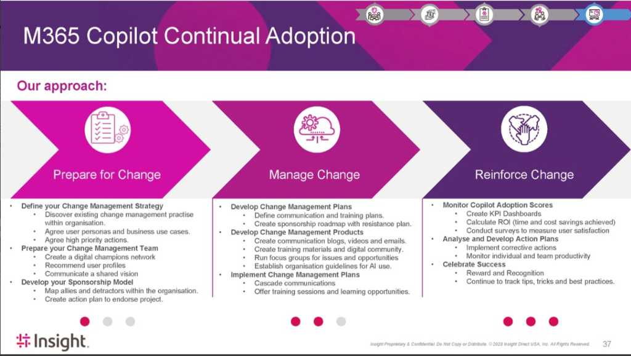
Anatomy of a strong ACM Offer – Example
Includes multi-stage process
Measurement of change incorporated from the start
Strategy devised, team constructed and briefed
Mechanisms to adjust approach based on learnings, and to share learnings with the teams more broadly
Sponsorship model developed
Defines detailed plans and products to support the change and manage resistance, with a long-term view
Incorporates feedback mechanisms and open dialog with teams

Slide 22

Example offer for Customer Service
Goals and challenges
Microsoft Copilot in Customer Service is your strategic partner to enable Customer Service teams. 43% of Customer Service reps report they were overwhelmed by the number of systems and tools needed to complete work.¹ With Microsoft Copilot, embedded directly into agent desktops, Customer Service teams can find answers fast and collaborate easily.
How Copilot and [Insert Partner Name] can help you achieve your goals...
AI & Copilot advisory | Get ready & deploy | Adoption & change management | Copilot Agents
[Insert service value prop] | [Insert service value prop] | [Insert service value prop] | [Insert service value prop]
Copilot can assist with…
Copilot assists Customer Service with tasks like process optimization, collaboration, and delivering a fast, tailored experience for customers.
Respond to a customer complaint
Communication logging
Identify a root cause
Improve key functional KPIs
Boost field efficiency
Manage service agents
 | First call resolution | In Customer Service, First Call Resolution (FCR) is a game changer because it improves customer satisfaction, enhances agent efficiency, and fosters long-term customer loyalty.
 | Average resolution time | Microsoft Copilot can help with lowering resolution times which in turn leads to increased agent productivity and higher customer satisfaction rates.
 | Service quality scores | AI is elevating service quality in the professional services industry by enabling smarter, more efficient, and customer-centric operations.
 | Customer satisfaction scores | Microsoft Copilot can improve customer satisfaction by providing real-time AI assistance for faster issue resolution, generating personalized email responses, analyzing customer feedback, and allowing agents to focus on delivering high-quality service.
Transform Customer Service processes with Copilot and [Insert Partner Offer]
[Insert partner offer summary]
¹Gartner. Gartner for Customer Service - The Connected Rep: Deliver better customer service by enabling reps with technology. 2023

Slide 23
Example offer for Finance
Goals and challenges
AI is transforming crucial tasks in Finance, such as budgeting, forecasting, financial analysis, and corporate performance management. AI-guided experiences can provide the ability to analyze vast amounts of data, utilize process-based data models to uncover valuable insights, and enhance the accuracy of financial projections.
How Copilot and [Insert Partner Name] can help you achieve your goals...
AI & Copilot advisory | Get ready & deploy | Adoption & change management | Copilot Agents
[Insert service value prop] | [Insert service value prop] | [Insert service value prop] | [Insert service value prop]
Copilot can assist with…
Copilot helps you improve Finance processes and access to information.
Optimize your financial operations
Contract review
Collections coordination
Improve key functional KPIs
Accounting document evaluation
Contract accounting guidance
Build a business case
 | Outsourcing spend | By assisting with everyday tasks, Microsoft Copilot can help increase time for additional analysis, proactive audits, collections processes, and financial reporting.
 | Cost per analysis request | Microsoft Copilot can help with lowering resolution times, which in turn leads to increased analyst productivity and higher customer satisfaction rates.
 | Days sales outstanding | Improve billing and collections processes by enhancing communications with customers and vendors.
 | Risk management | Microsoft Copilot frees up time for critical decisions, streamlining audits, simplifying collections, and accelerating financial reporting.
Transform Finance processes with Copilot and [Insert Partner Offer]
[Insert partner offer summary]

Slide 24
Example offer for HR
Goals and challenges
With changing worker expectations, multi-generational workforces, and hybrid workplaces, it’s becoming harder to keep talented people. Copilot can help to simplify access to data, improve quality, and increase creativity, resulting in improvements to essential key performance indicators.
How Copilot and [Insert Partner Name] can help you achieve your goals...
AI & Copilot advisory | Get ready & deploy | Adoption & change management | Copilot Agents
[Insert service value prop] | [Insert service value prop] | [Insert service value prop] | [Insert service value prop]
Copilot can assist with…
Copilot helps you improve HR processes and access to information.
Streamline your recruiting process
Manage internal job transitions
Streamline benefits and compensation
Improve organizational health metrics
Improve key functional KPIs
Improve onboarding and development processes
Update policy document
 | Cost per hire | Organizations can improve the hiring process by using Copilot to help write job descriptions, summarize interviews, avoid bias when identifying top candidates, improve candidate communications, and improve onboarding processes.
 | Employee turnover rate | Copilot can help all employees get more satisfaction in their job by assisting with challenging tasks and instead working on higher value activities. It also makes many tasks faster, which can reduce overtime requirements.
 | Onboarding time | Speed time to value of new employees by simplifying access to information and training.
Transform HR processes with Copilot and [Insert Partner Offer]
[Insert partner offer summary]

Slide 25
Example offer for Legal
Goals and challenges
Legal departments are navigating an increasingly dynamic and complex legal, regulatory, and compliance landscape. The workload is growing not just in volume, but in speed and complexity. By harnessing the power of Microsoft Copilot, Legal departments can transform how they work to meet these demands and enhance the efficiency, quality, and scale of their work to deliver broad impact.
How Copilot and [Insert Partner Name] can help you achieve your goals...
AI & Copilot advisory | Get ready & deploy | Adoption & change management | Copilot Agents
[Insert service value prop] | [Insert service value prop] | [Insert service value prop] | [Insert service value prop]
Copilot can assist with…
Copilot assists Legal teams to deliver broad impact in their ability to advise clients, drive efficiencies, and optimize workflows.
Develop a compliance video
Quicker Legal guidance
Improve key functional KPIs
Quicker contract review
Licensing agreement negotiation
 | Outside counsel spend | Automate routine tasks to bring work in-house and become less reliant on outside legal counsel assistance.
 | Cost per internal review | Reduce review times which in turn leads to increased attorney productivity and higher client satisfaction rates.
 | Enhance Legal advisory services | Efficiently find relevant information to facilitate rapid decision making and draft guidance with clear and relevant advisory points.
 | Streamline transactional processes | Increase efficiency, understanding, and consistency of contract reviews for increased velocity and better decision making.
Transform Legal processes with Copilot and [Insert Partner Offer]
[Insert partner offer summary]

Slide 26
Example offer for Marketing
Goals and challenges
It’s more important than ever to deliver creative, high-quality content that is authentic to your brand. At the same time, cross-functional campaigns are becoming more complex to manage across new surfaces. Marketing teams must overcome the traditional communications gap between Marketing and Sales and Marketing and product teams to develop a cohesive strategy for success.
How Copilot and [Insert Partner Name] can help you achieve your goals...
AI & Copilot advisory | Get ready & deploy | Adoption & change management | Copilot Agents
[Insert service value prop] | [Insert service value prop] | [Insert service value prop] | [Insert service value prop]
Copilot can assist with…
Copilot can help to achieve alignment between teams and help to generate creative content that can deliver a marketing message effectively.
Creating a marketing Bill of Materials
Streamline market research and strategy
Content creation using Copilot
Improve key functional KPIs
 | Agency spend | Copilot helps reduce the cost spent on outsourcing content creation.
 | Leads generated | By analyzing the competitive landscape, enhancing demand generation materials, and improving internal collaboration, Copilot can help marketers generate more leads and reach new customers.
 | Brand value | Copilot elevates your brand message by helping you develop more captivating and engaging content – whether it’s email campaigns, blogs, or website copy. Copilot also helps you brainstorm your social content, sparking interest and expanding your brand reach.
 | Cost per lead | Copilot helps reduce the cost spent per lead by simplifying analysis, content creation, and customization.
Collect and share product feedback
Create a new offering
Product launch
Transform Marketing processes with Copilot and [Insert Partner Offer]
[Insert partner offer summary]

Slide 27
Example offer for Sales
Goals and challenges
Based on Microsoft research, selling is getting harder, with 79% of sellers saying they need to support more accounts and are spending 70% of their time on administrative tasks, such as research, planning, generating proposals, data entry, and internal meetings.¹
How Copilot and [Insert Partner Name] can help you achieve your goals...
AI & Copilot advisory | Get ready & deploy | Adoption & change management | Copilot Agents
[Insert service value prop] | [Insert service value prop] | [Insert service value prop] | [Insert service value prop]
Copilot can assist with…
Copilot assists Sales teams with tedious tasks like catching up on pipeline, updating CRM data, preparing for meetings, and analyzing calls, so they can focus on closing the deal.
Accelerate customer research and sales preparation
Improve customer meetings
Make a customized pitch
Improve key functional KPIs
Quicker customer response and CRM updates
Respond to an RFP
Create an unsolicited proposal
 | Opportunities pursued | Simplifying and automating tasks like preparing for meetings, tracking tasks, sending emails, creating proposals, and researching customer and product information can allow sellers to pursue more opportunities.
 | Close rate | Improving the quality of marketing content and customer interactions such as emails and meetings can help to improve close rates.
 | Deal size | Sellers can use Copilot to get suggestions for cross-selling opportunities and then research a better together story. Copilot also assists in pulling together quotes and proposals.
 | Customer retention | Improving the quality of Sales materials and interactions helps with retention, but the rest of the company can contribute as well from improved support interactions and first call resolution to improved customer feedback processes to product development.
Transform Sales processes with Copilot and [Insert Partner Offer]
[Insert partner offer summary]
¹ Microsoft Internal Report

Slide 28
Publishing an offer

Slide 29
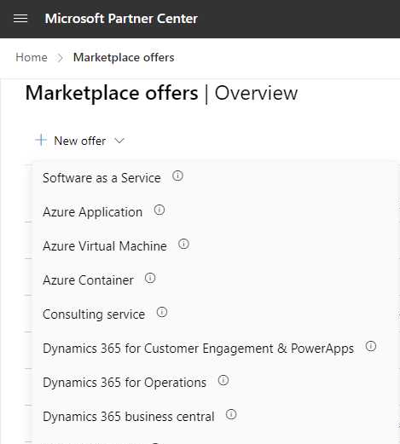
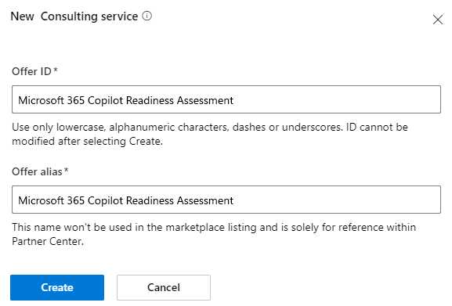
Microsoft 365 Copilot offer
The commercial marketplace
Offer Setup
Offer Setup
​Select + New offer
Properties
Offer Listing
Pricing and Availability
​Select Consulting service
Co-sell with Microsoft
​Create an Offer ID and Offer alias
​Select Create

Slide 30
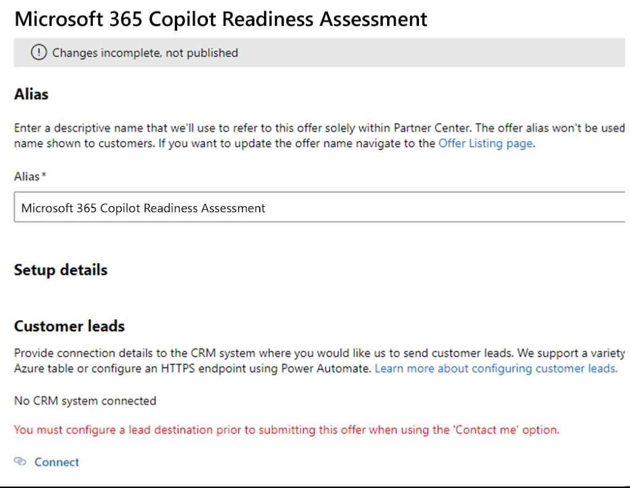
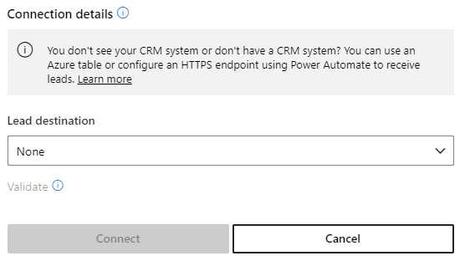

Microsoft 365 Copilot offer
The commercial marketplace
Offer Setup
Offer Setup
Properties
​Customer leads: Select the destination where the customer leads should be routed to (e.g., CRM or email contact).
Offer Listing
Pricing and Availability
Co-sell with Microsoft
​Select Save draft

Slide 31
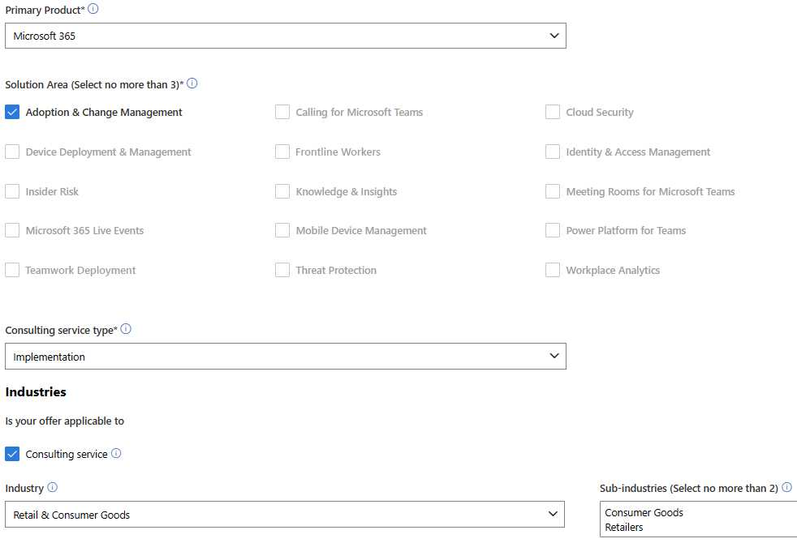
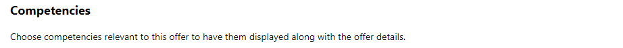
Microsoft 365 Copilot offer
The commercial marketplace
Offer Setup
Primary Product: Select Microsoft 365
Offer Setup
Solution Area: Select the below three solution areas (e.g.,)
Adoption & Change Management
Properties
Offer Listing
Pricing and Availability
Co-sell with Microsoft
Consulting service type: Selecting Implementation is encouraged
Industry: Select one or more industries that are the focus for your company and offer
Competencies:* Select your relevant competencies
*Recommend $1 since the terms, conditions, and pricing typically vary and are custom to each engagement. You should also include the exact phrase “terms, conditions, and pricing are custom to each engagement” in the solution description.

Slide 32
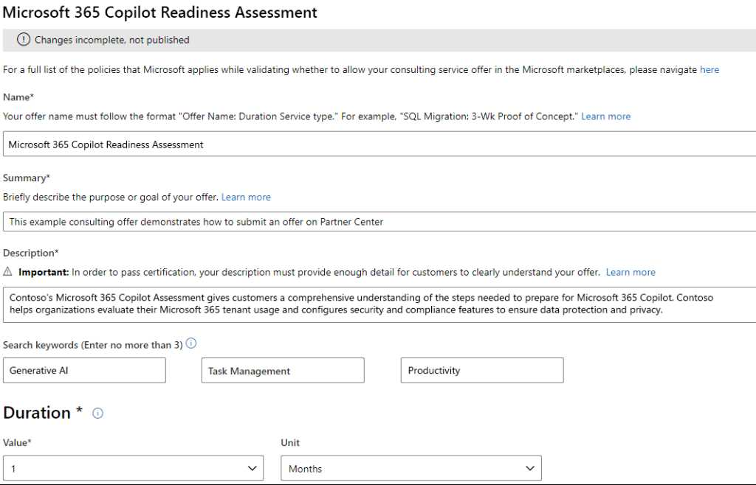
Microsoft 365 Copilot offer
The commercial marketplace
Offer Setup
To let customers quickly identify offers of interest, your listing must clearly, concisely, and accurately convey the type of offer, the value proposition for your offer, and requirements for its adoption.
Offer Setup
Summary: A concise, well-written summary of the offer or plan and its intended use.
Properties
Offer Listing
Pricing and Availability
Co-sell with Microsoft
Description:* A description that identifies the audience for the offer, briefly and clearly explains the unique value of the offer, identifies supported Microsoft products and other supported software, and includes any requirements for its use. Refer to the “Sample Final Offer” text here.
*Recommend $1 since the terms, conditions, and pricing typically vary and are custom to each engagement. You should also include the exact phrase “terms, conditions, and pricing are custom to each engagement” in the solution description.

Slide 33


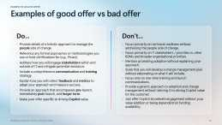
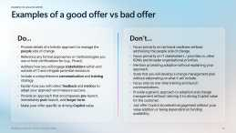
Microsoft 365 Copilot offer
The commercial marketplace
Offer Setup
To let customers quickly identify offers of interest, your listing must clearly, concisely, and accurately convey the type of offer, the value proposition for your offer, and the requirements for its adoption.
Offer Setup
Search keywords: Add up to three keywords to help customers find your solutions; refer to “Anatomy of the Offer” guidance (images linked below) for recommendations.
Properties
Offer Listing
Pricing and Availability
Co-sell with Microsoft
Duration:* Enter one month as the typical engagement cycle; although this is a required field on the Offer listing pane, it will not be visible to customers on the commercial marketplace.
*If publishers include the following language verbatim in the Description field: “terms, conditions, and pricing are custom to each engagement”, they do not need to include a Duration in the offer title.

Slide 34
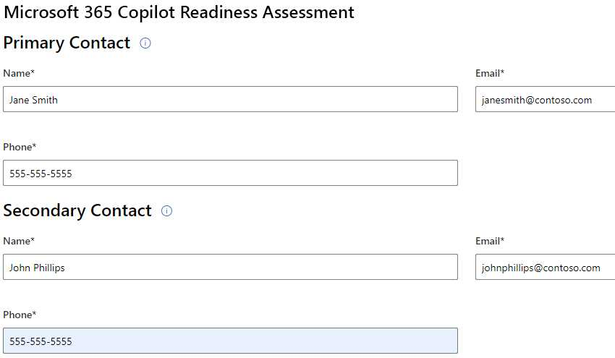
Microsoft 365 Copilot offer
The commercial marketplace
Offer Setup
You will also need to provide a Primary and Secondary Contact to Microsoft. This information will not be visible to the customer on the commercial marketplace.
Microsoft will reach out to the Primary Contact if a customer is not contacted within 48 hours of a lead submission. After this, if the Primary Contact is unresponsive for 24 hours, Microsoft will reach out to the Secondary Contact.
Offer Setup
Properties
Offer Listing
Primary Contact: Add the name and contact information of the person who will handle lead submissions.
Pricing and Availability
Co-sell with Microsoft
Secondary Contact: Add the name and contact information of a secondary person who can handle lead submissions.

Slide 35
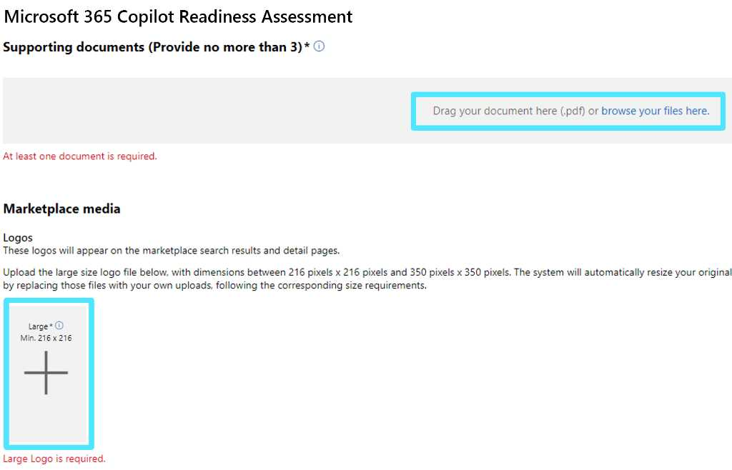
Microsoft 365 Copilot offer
The commercial marketplace
Offer Setup
Supporting documents: Uploading your customized one-pager meets this requirement. You can also upload up to two additional sales and marketing assets, such as white papers, brochures, checklists, or PowerPoint presentations.
Offer Setup
Properties
Offer Listing
Pricing and Availability
Co-sell with Microsoft
Marketplace media: Upload your logo.

Slide 36
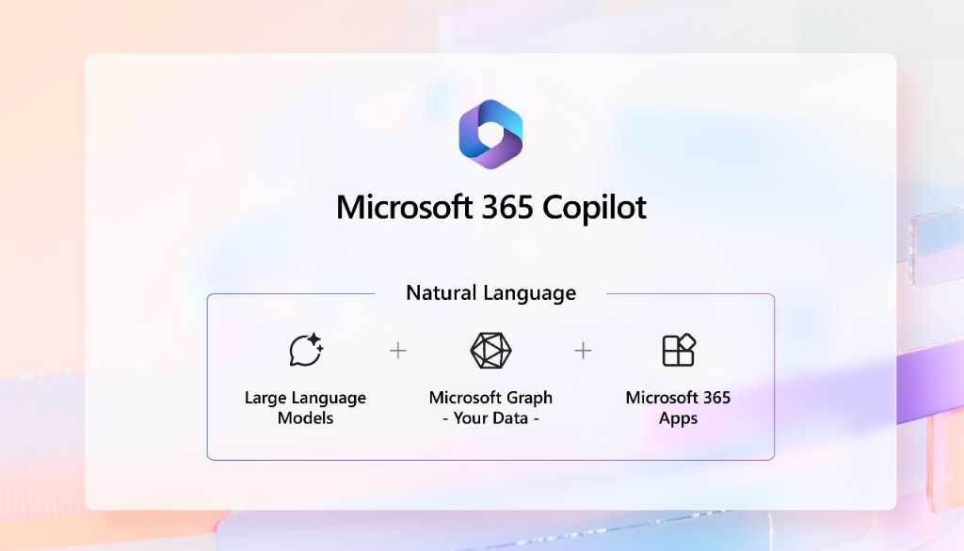
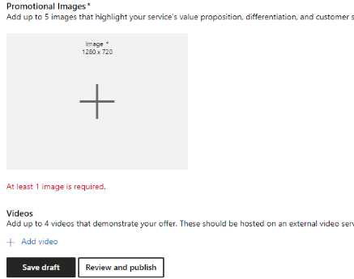
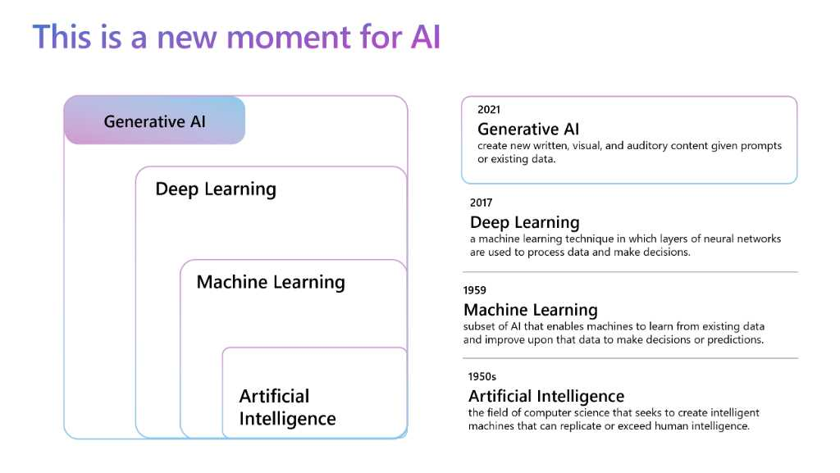
Microsoft 365 Copilot offer
The commercial marketplace
Offer Setup
Promotional Images: Upload up to five images. See samples below.
Offer Setup
Properties
Offer Listing
Pricing and Availability
Co-sell with Microsoft
Videos: If available, upload up to four videos that are externally accessible.
​Select Save draft

Slide 37
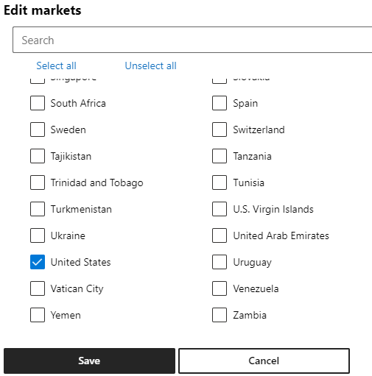
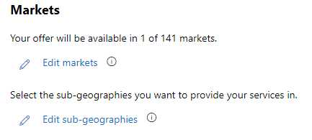
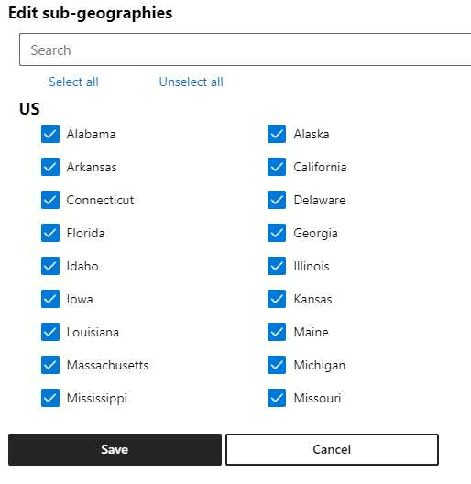
Microsoft 365 Copilot offer
The commercial marketplace
Offer Setup
Edit markets: Here you will select the markets where your solution can be deployed.
Offer Setup
Properties
Offer Listing
Pricing and Availability
Co-sell with Microsoft
Edit sub-geographies: Here you will select the sub-markets within each country where your solution can be deployed.

Slide 38
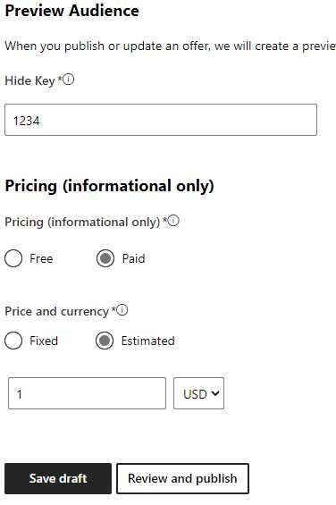
Microsoft 365 Copilot offer
The commercial marketplace
Offer Setup
Hide Key: Choose a combination of numbers or use the auto-generated key. This key is used to preview your offer before publishing on the commercial marketplace. It can be used as a final “check” to ensure that your offer is ready to be published.
Offer Setup
Properties
Offer Listing
Pricing and Availability
Pricing: Select Paid
Co-sell with Microsoft
Price and currency:* We recommend that you choose Estimated with a value of 1 (one). Alternatively, you could provide an estimated price that can help customers directionally determine if an offer fits in their budget.
​Select Save draft
*Recommend $1 since the terms, conditions, and pricing typically vary and are custom to each engagement. You should also include the exact phrase “terms, conditions, and pricing are custom to each engagement” in the solution description.

Slide 39
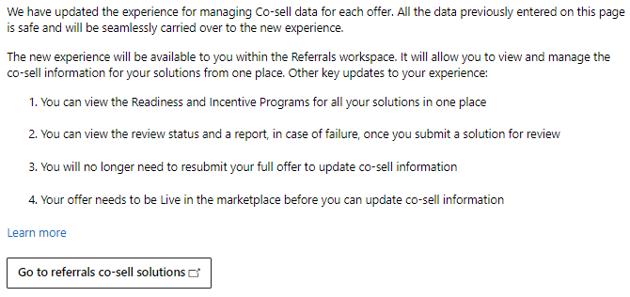
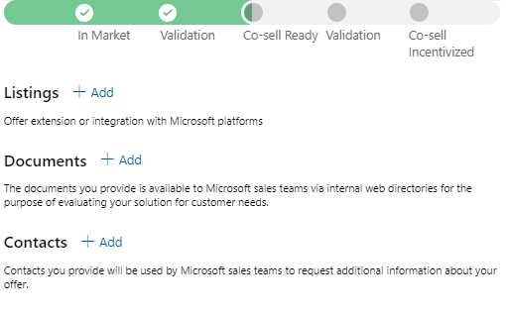
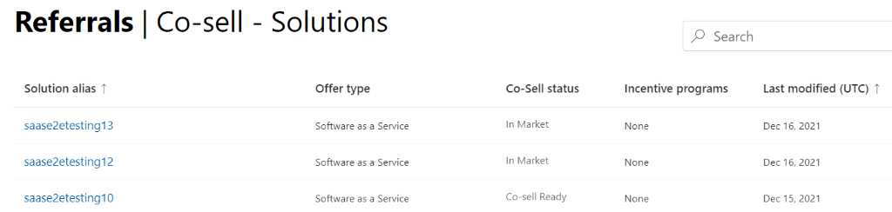
Microsoft 365 Copilot offer
The commercial marketplace
Offer Setup
Please follow the Go to the co-sell solutions list link that will redirect you to a list of offers. Find and select your offer to add co-sell information in each section, listing, document, and contact.
Offer Setup
Properties
Offer Listing
Pricing and Availability
Co-sell with Microsoft

Slide 40
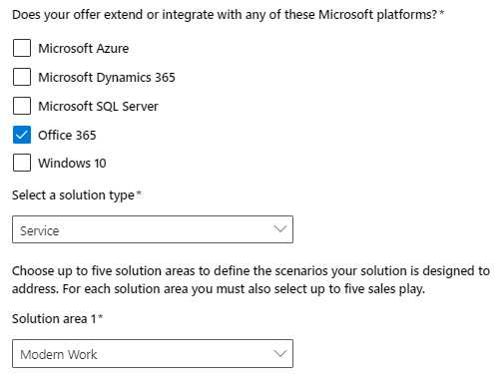
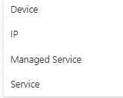

Microsoft 365 Copilot offer
The commercial marketplace
Offer Setup
Listing: Select all the Microsoft platforms that your solution is compatible with
Offer Setup
Properties
Offer Listing
Solution type: Select Service
Pricing and Availability
Co-sell with Microsoft
Solution area: Select Modern Work
​Select Save

Slide 41
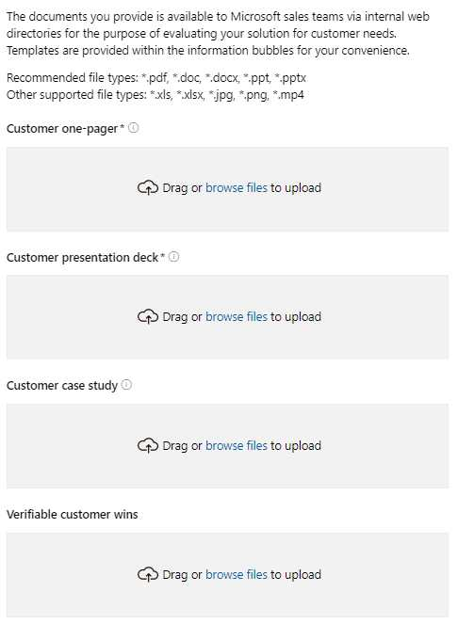
Microsoft 365 Copilot offer
The commercial marketplace
Offer Setup
Solution/offer one-pager: Upload your customized one-pager.*
Offer Setup
Properties
Offer Listing
Solution presentation deck: Upload your customized pitch deck.*
Pricing and Availability
Co-sell with Microsoft
​Select Save
*Please add documentation to the other fields as you have it available. However, this is not required to be co-sell prioritized.

Slide 42
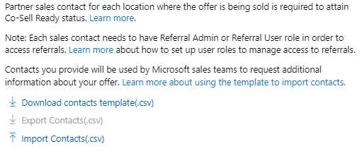
Microsoft 365 Copilot offer
The commercial marketplace
Offer Setup
Contacts: a. Download the contacts template. b. Re-upload the template with your partner sales contacts for each location where you are selling.
Offer Setup
Properties
Offer Listing
Pricing and Availability
Co-sell with Microsoft
​Select Save

Slide 43

Microsoft 365 Copilot
Resources
Access all the key resources at: aka.ms/AIFutureOfWorkPartner
The Microsoft 365 Copilot site:
Microsoft 365 Copilot – Microsoft Adoption
Partner Community
Nominate yourself: https://aka.ms/CopilotPartnerCommunity
Microsoft 365 Copilot falls under the Microsoft 365 Product Terms. Review the Microsoft privacy policy and service documentation.

Slide 44

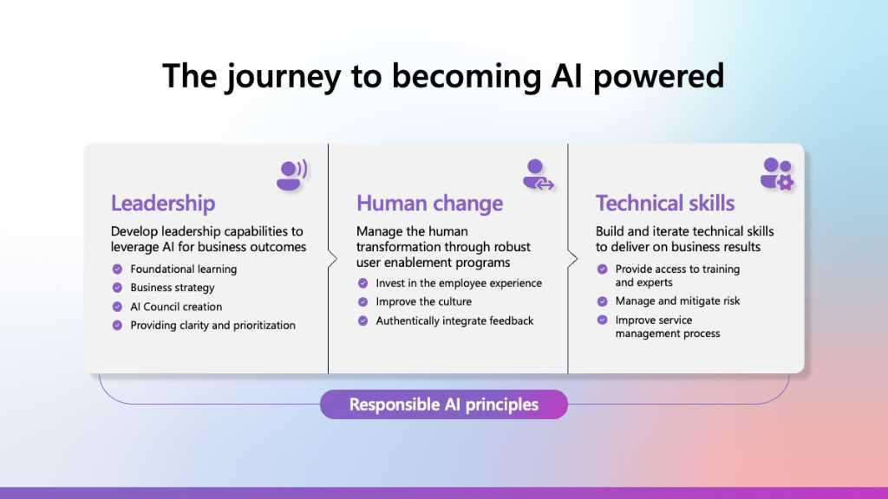
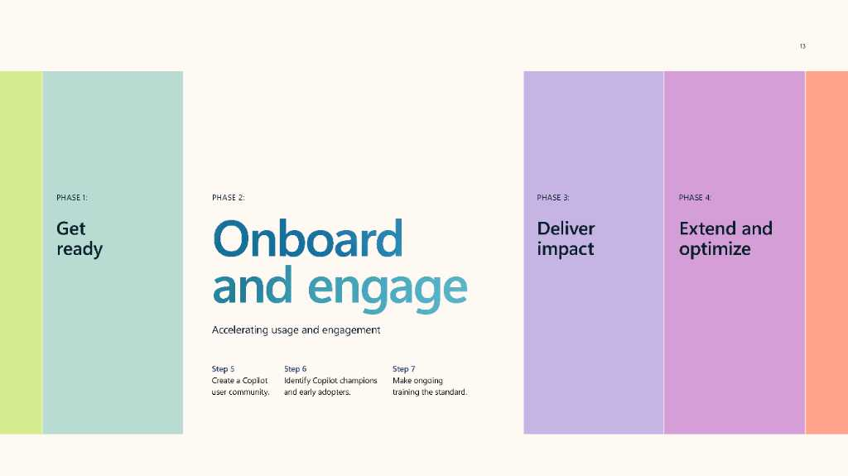
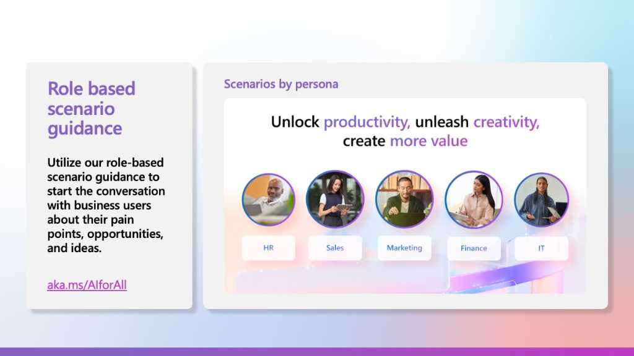

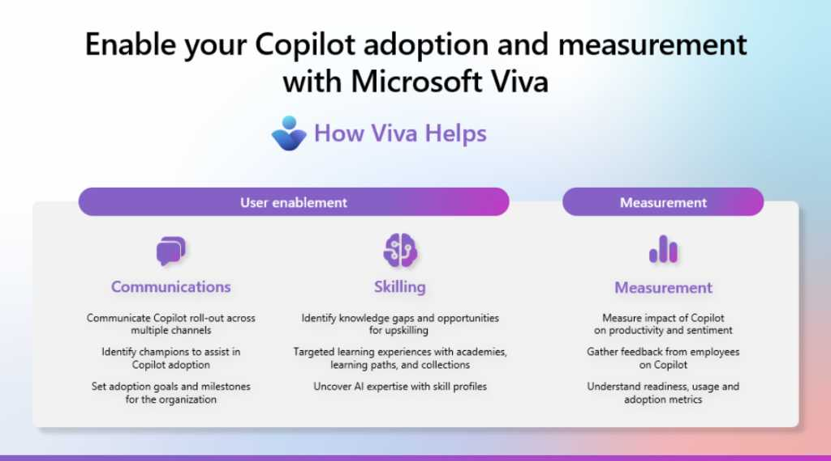
Copilot Success Kit
What’s included
Implementation summary guide
Copilot adoption guide for business leaders
User Enablement Guide
Technical Readiness Guide
Accelerate your path with Microsoft Viva
PowerPoint
PowerPoint
eBook
PowerPoint
PowerPoint
aka.ms/CopilotSuccessKit

Slide 45

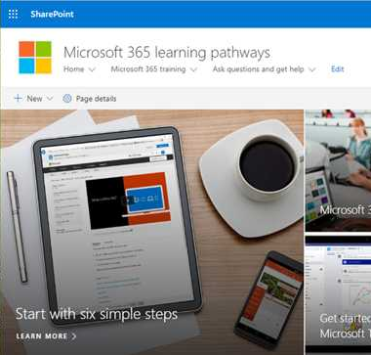
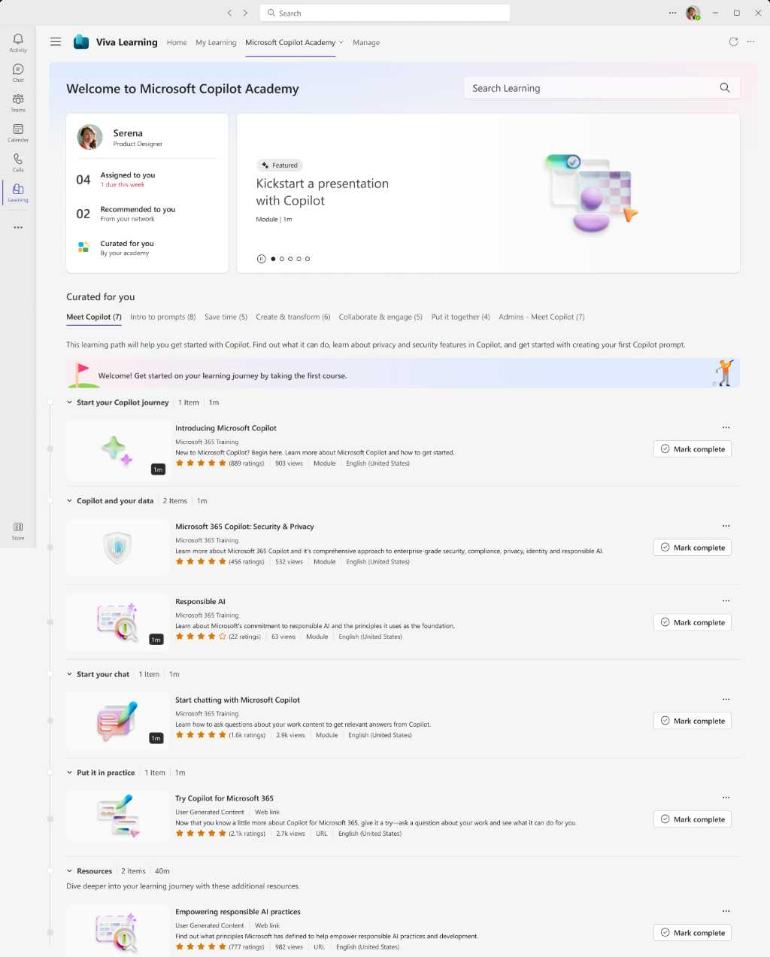
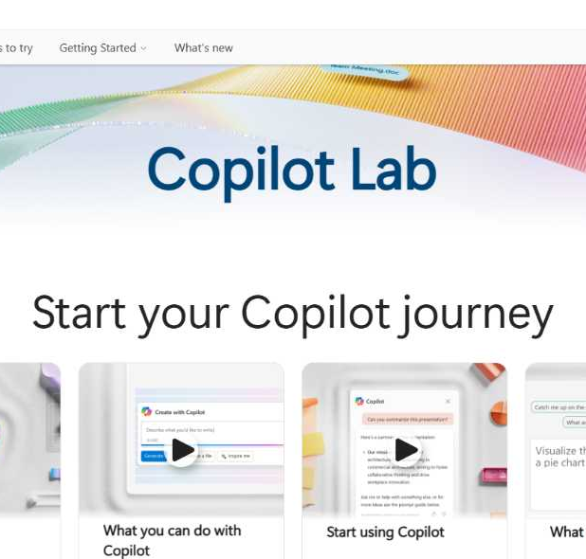
Microsoft 365 Copilot skilling experiences
Microsoft Learn
Free, on-demand training content for skill development.
Step-by-step exercises guiding learners through common Copilot prompts and use cases.
Microsoft Copilot Academy
Centralized location to help with the basics of Copilot learning and upskilling, pulling the best content from available free Microsoft sources.
Structured content in easily consumable learning paths curated by Microsoft experts.
Develop your AI interaction skills from your Viva Learning app in Teams or webapp.
Copilot Lab
Free location to meet, learn about, and test the capabilities of Copilot.
Improve your prompt engineering skills in an interactive hands-on environment.
Downloadable assets for customization available at adoption.microsoft.com/copilot

Slide 46





Top 10 to ‘Try First’ with Microsoft 365 Copilot
Foundational skills for new users
1
2
3
4
5
Recap a meeting – Let Copilot keep track of key topics and action items so you can stay focused during the meeting and avoid listening to the recording after.
Summarize an email thread
– Get quickly caught up with a long, complex email thread.
Draft email
– Personalize the tone and length.
Summarize a document
– Get right down to business by summarizing long documents and focusing on the relevant sections.
Tell me about a topic/project
– Provide insights and analysis from across multiple sources to get up to speed quickly.
Draft an email to [name] that informs them that Project X is delayed two weeks. Make it short and casual in tone.
Draft an email with notes and action items from meeting.
Click the Summarize icon.
Give me a bulleted list of key points from the file.
Tell me what’s new about topic organized by emails, chats, and files.
6
7
8
9
10
Give me some ideas for …
– Boost your creativity with ideas for your work, such as agendas, product names, social media posts, etc.
Help me write …
– Jumpstart creativity and write and edit like a pro by getting a first draft in seconds.
What did they say …
– When you vaguely remember someone mentioning a topic, have Copilot do the research.
Revise this content
– When you’ve got a rough draft of an idea, turn it into usable text, and then vary the length and tone.
Translate a message
– With business becoming increasingly international, it’s important to be able to read or write messages in other languages.
Suggest 10 compelling taglines based on file.
Generate three ways to say [x].
What did person say about topic?
Rewrite with Copilot.
Translate the following text into French:
For more prompts, visit the Copilot Lab at: aka.ms/CopilotLab

Slide 47
Thank you

